Slide 1
HANOI UNIVERSITY OF SCIENCE AND TECHNOLOGY
SCHOOL OF INFORMATION AND COMMUNICATION TECHNOLOGY
Introduction to Data Science (IT4142E)
TREND ANALYSIS ON YOUTUBE GAMING VIDEOS
LECTURER: ASSOC. PROF. PHD. THAN QUANG KHOAT
GROUP 16 PHAN THAI VIET 20204895
NGUYEN HUNG ANH 20200028 KIEU ANH VAN 20204934
NGUYEN TRUNG HIEU 20204909 DOAN NGOC VINH 20204935

Slide 2

1
Introduction
Youtube was created in 2005 and was later acquired by Google.
Youtube has grown to become a major social network and search enginge.
YouTube has a sophisticated recommendation video strategy.
Challenge for new content creators to understand why a video gets viral and others don’t.

Slide 3
1
Introduction
Youtube gaming is a section of the YouTube platform that is specifically dedicated to gaming content.
YouTube gaming features a wide range of content, including gameplay footage, game trailers, walkthroughs, reviews, and more.
With millions of users and billions of views, YouTube gaming has become an important platform for the gaming community.

Slide 4
1
Introduction
2
Aims and objectives
Getting to know Youtube API and how to obtain video data.
Analyzing video data and verify different common factors about what makes a video do well on Youtube.
Input: A list of recent viral gaming videos crawled from YouTube (with attributes such as like count, title, description, date of publication, etc.)
Output: Analysis resulted from answering numerous questions and modeling.

Slide 5
1
Introduction
2
Aims and objectives
3
Steps of the project
Data collection
Data pre-processing
Exploration
Modelling

Slide 6
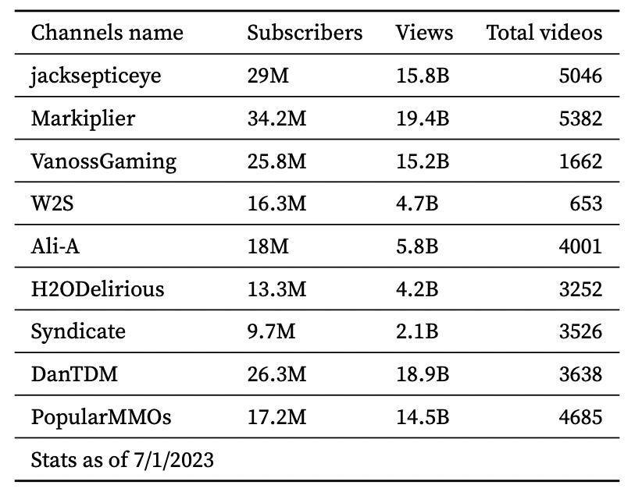
1
Data crawling with youtube API
The dataset used in this project is collected using the YouTube API.
The gaming channels are chosen manually based on their popularity, which include the total number of views, likes and subscribers.
There are total of 9 channels selected, all of which are english-speaking gaming channels.
2
Preprocessing & feature engineering

Slide 7
2
Preprocessing & feature engineering
Videos’ initially attributes are : video_id, channelTitle, title, description, tags, publishedAt, duration, definition, caption.
We check for null value and convert some columns’ value to integer.

Slide 8
2
Preprocessing & feature engineering
Enrich the data with few steps:
Create published date column
Convert video duration to integer
Calculate number of tags
Calculate comments and likes per 1000 view ratio
Calculate title character length

Slide 9
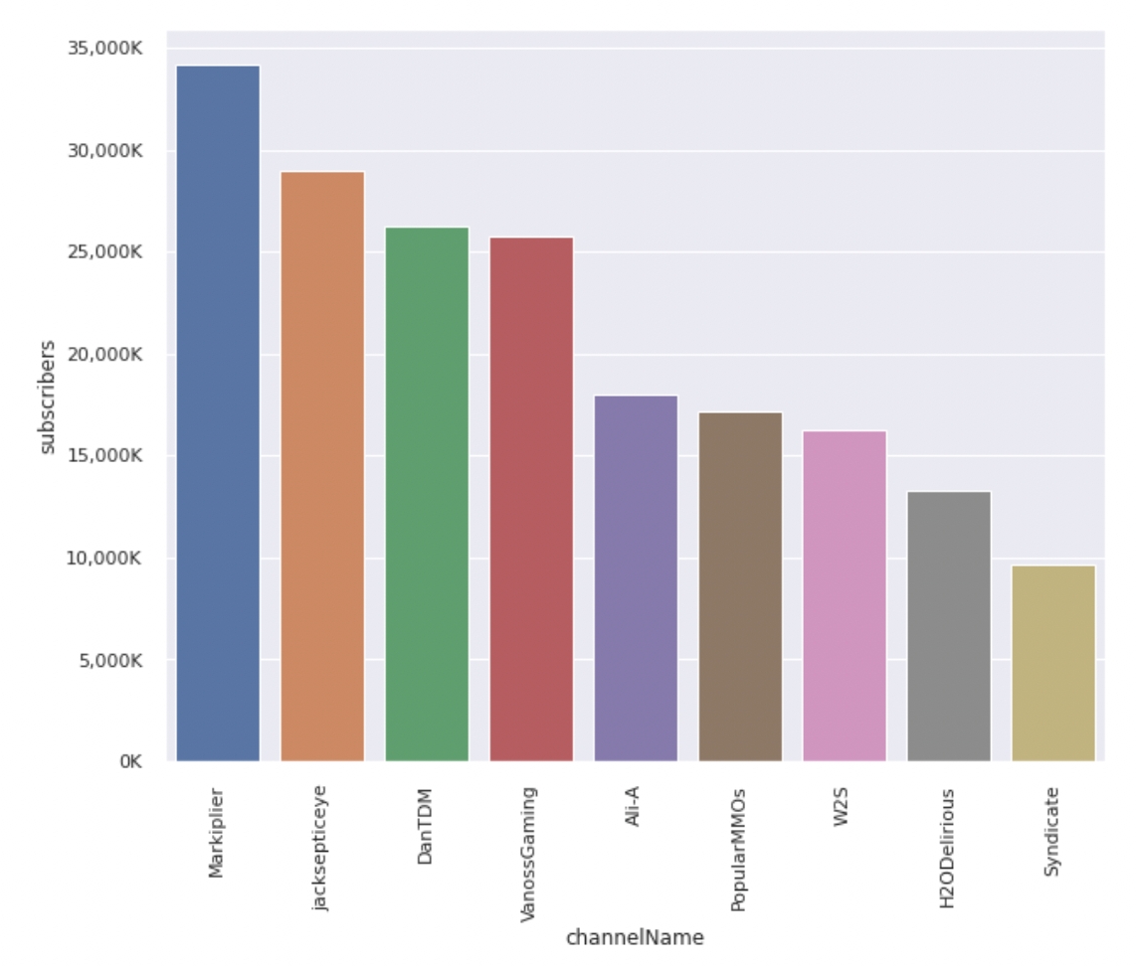
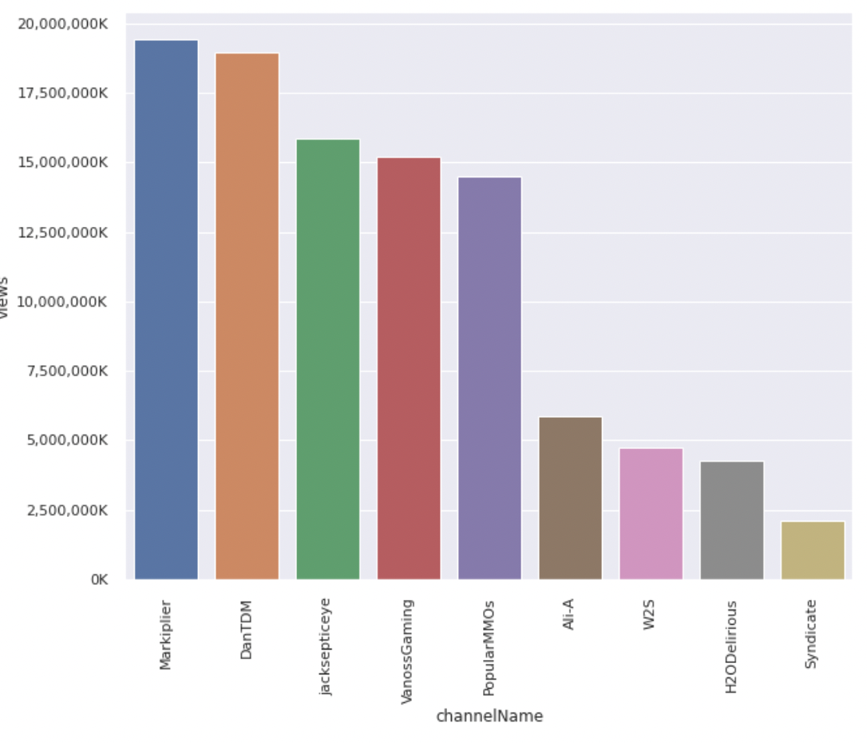
3
Exploratory analysis
Ranking channels

Slide 10
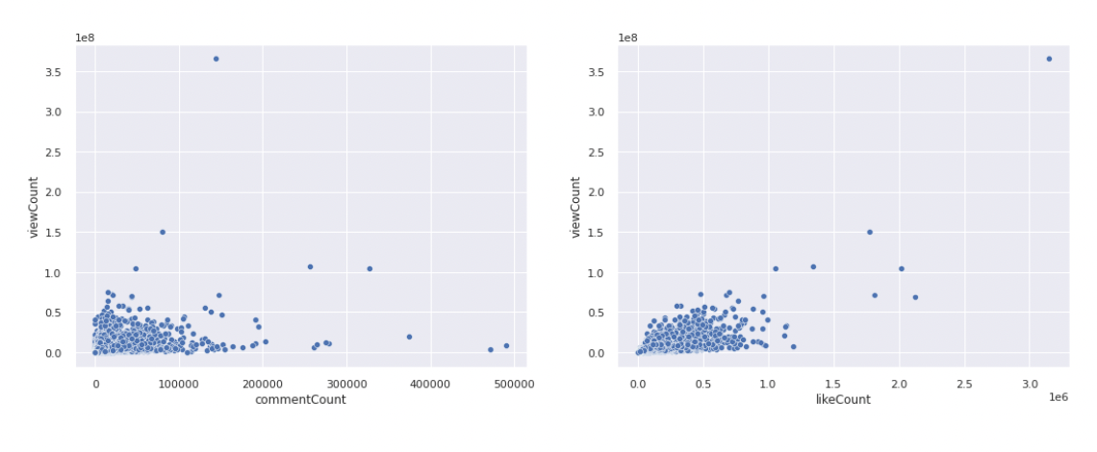
3
Exploratory analysis
Correlation between likes / views and comments / views.

Slide 11
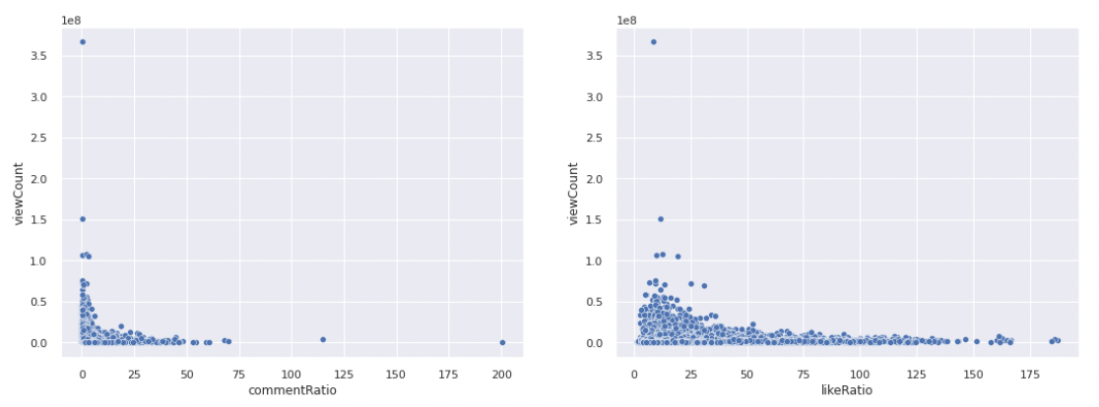
3
Exploratory analysis
Correlation between like ratio / views and comment ratio / views.

Slide 12
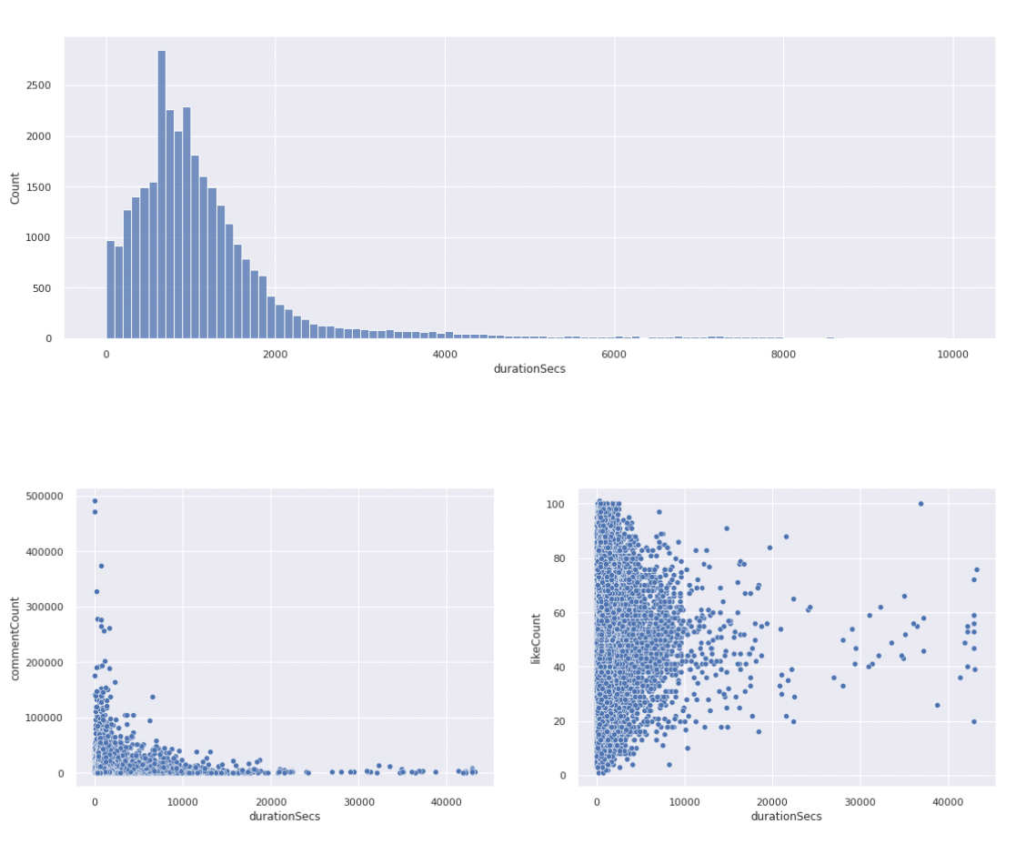
3
Exploratory analysis
Correlation between duration and views .

Slide 13
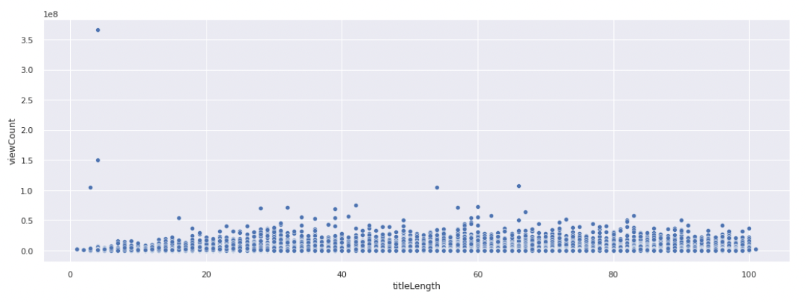
3
Exploratory analysis
Correlation between title length and views .

Slide 14
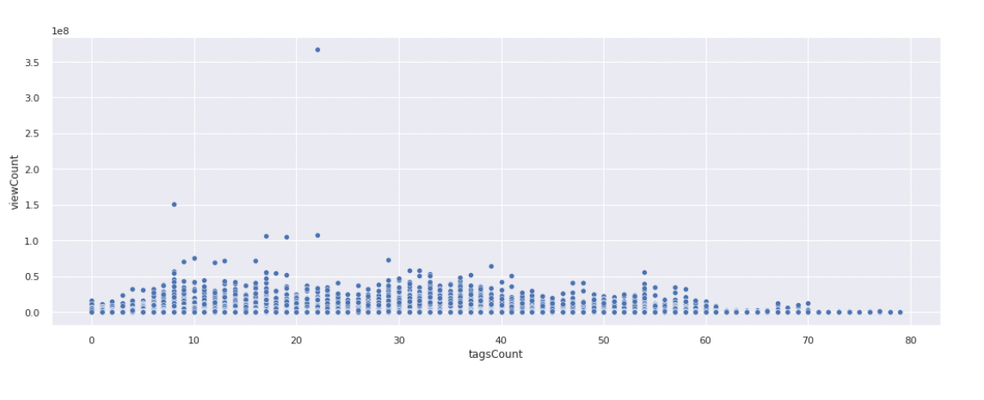
3
Exploratory analysis
Correlation between number of tags and views.

Slide 15
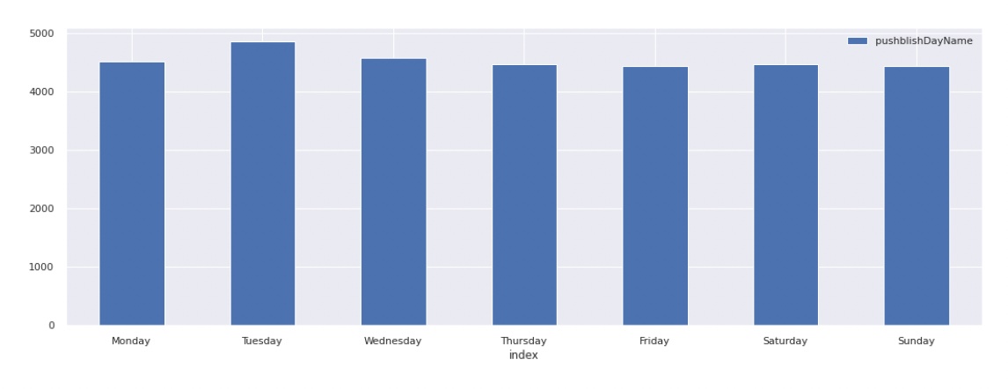
3
Exploratory analysis
Correlation between published day / views .

Slide 16
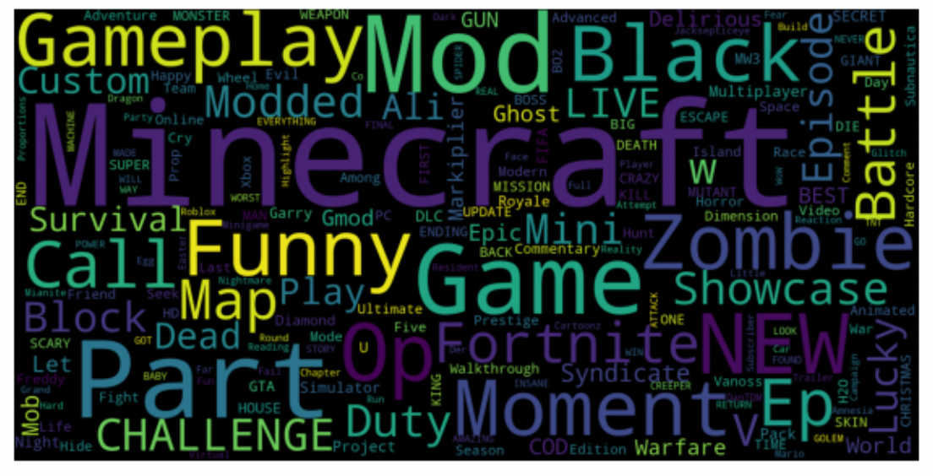
3
Exploratory analysis
Word cloud for word in title.

Slide 17
4
Modeling
TF-IDF VECTORIZATION: a widely adopted method in the field of Natural Language Processing for representing the significance of words in a document.
The technique calculates the Term Frequency (TF) of a word, and the Inverse Document Frequency (IDF), which reflects the rarity of the word in the entire corpus.
In our analysis, we utilize the TF-IDF vectorization technique to convert all text attributes into numerical representations.
The K-means clustering algorithm is employed to categorize videos into distinct groups by its title characters.

Slide 18
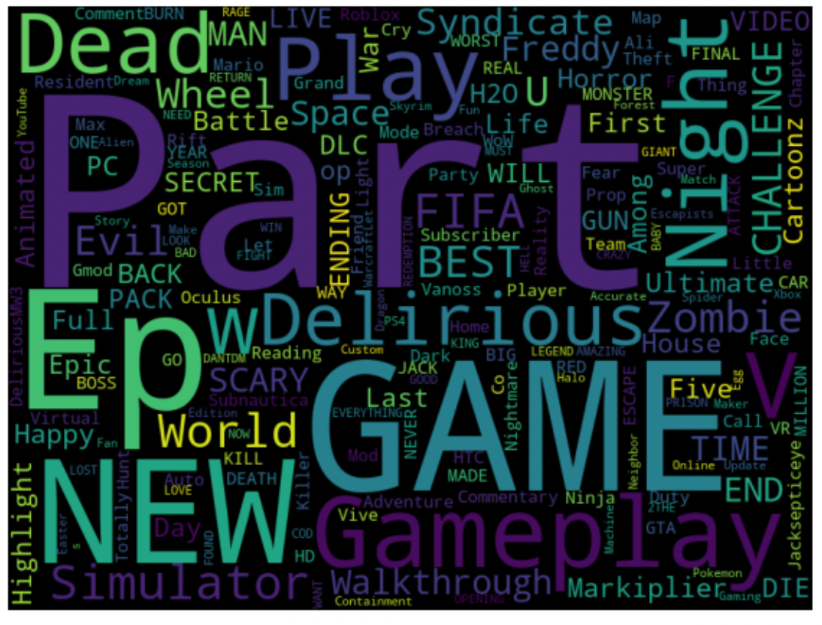
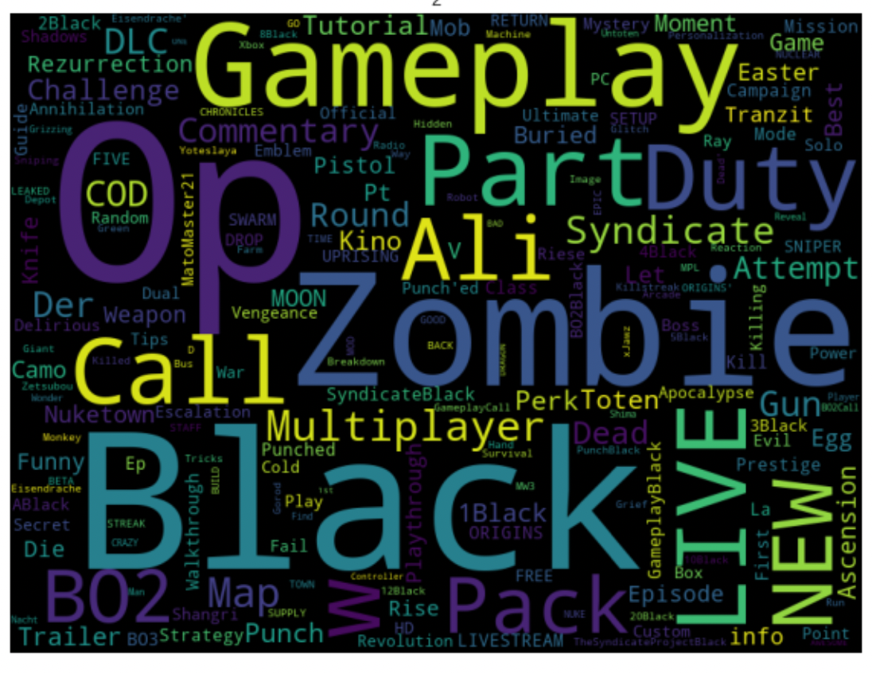
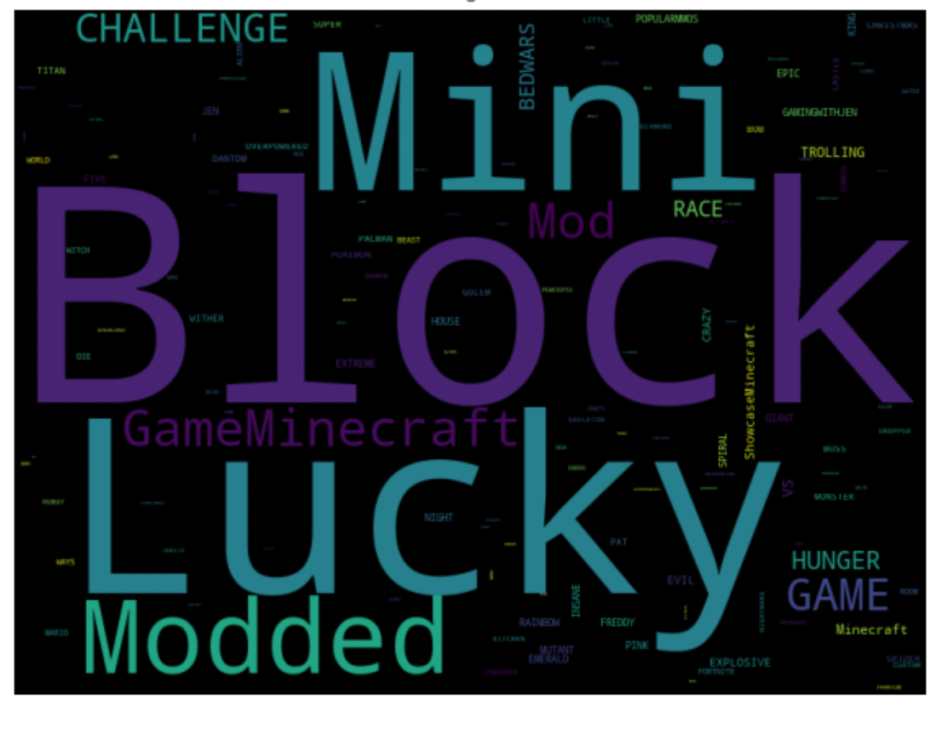
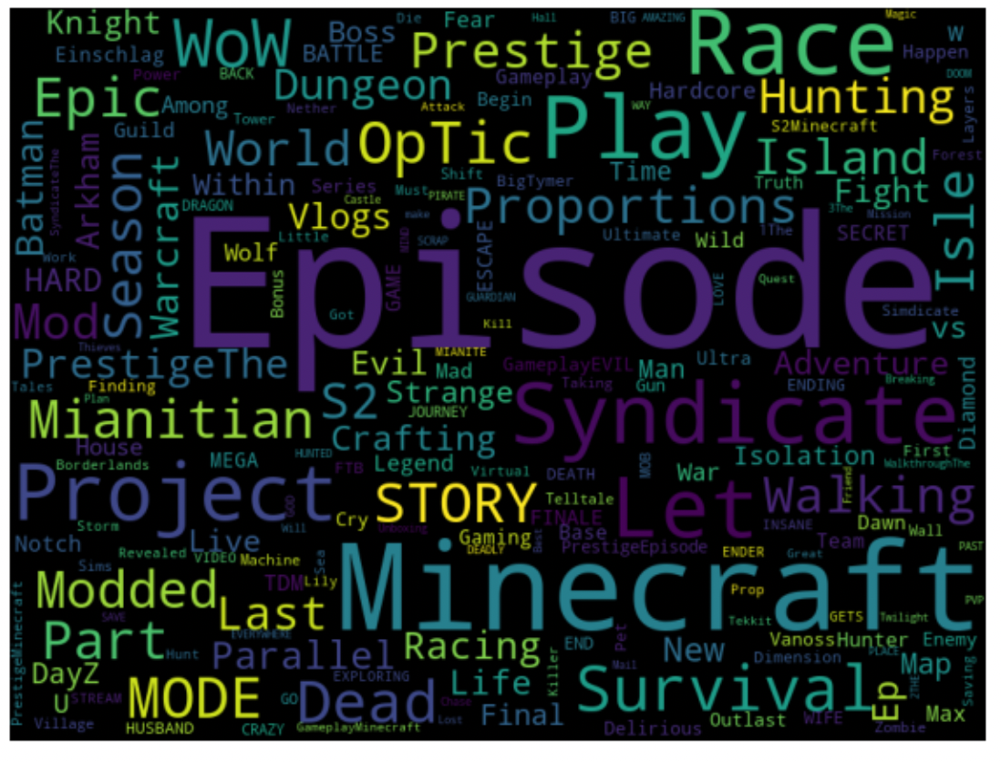
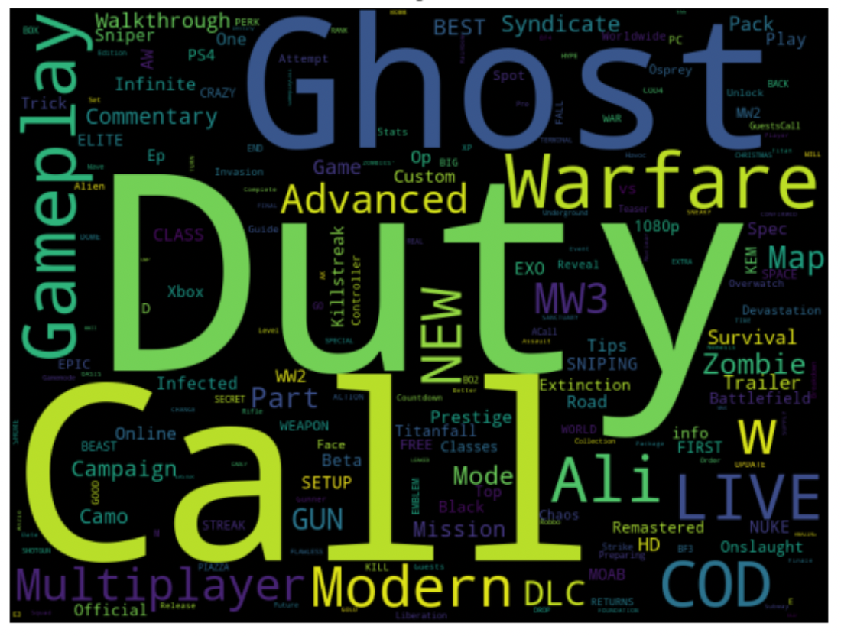
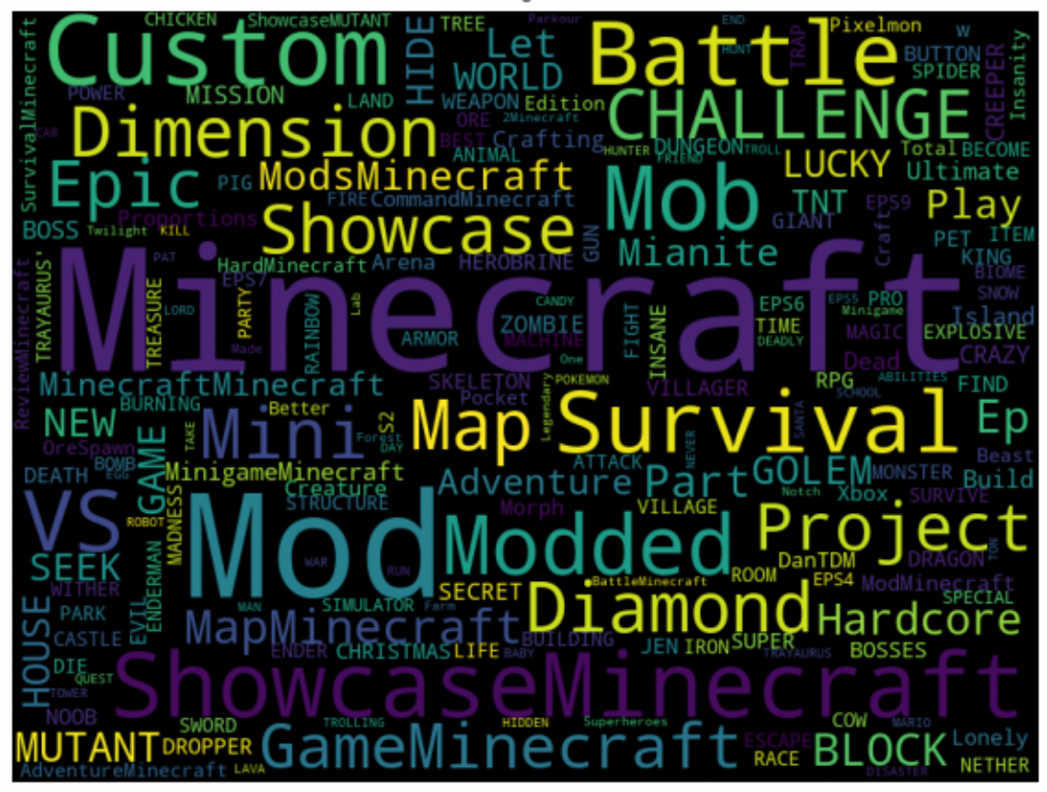
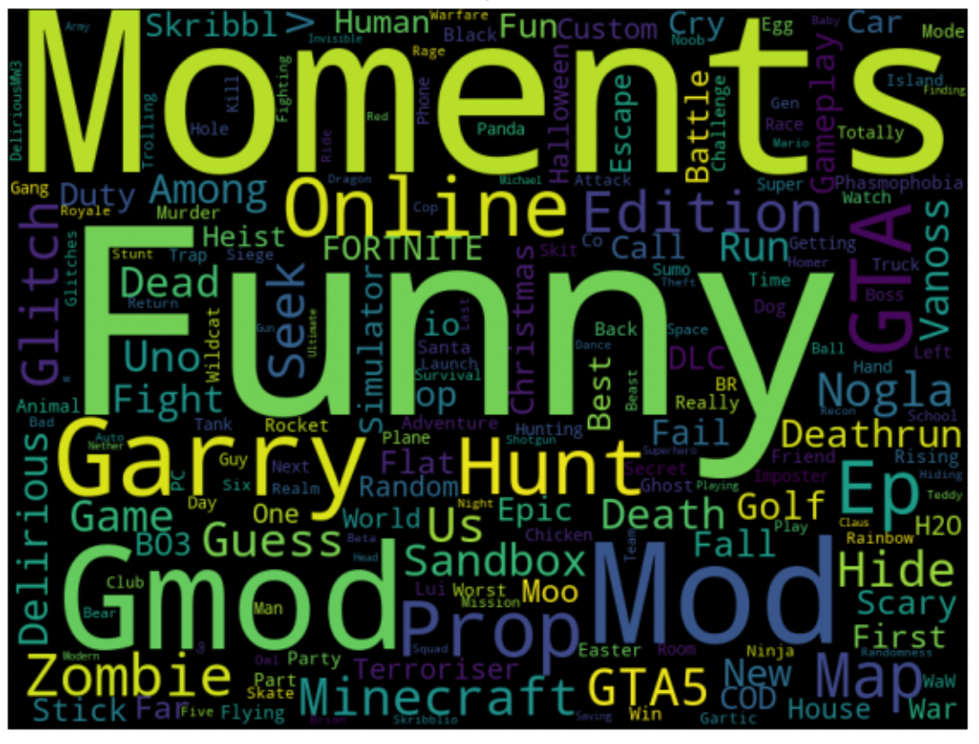
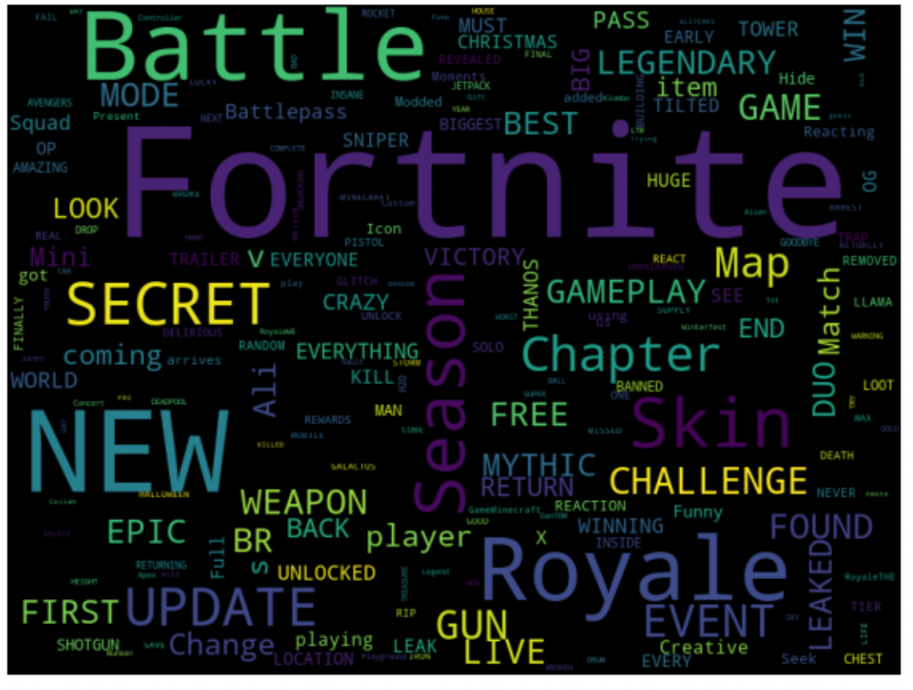
4
Modeling

Slide 19
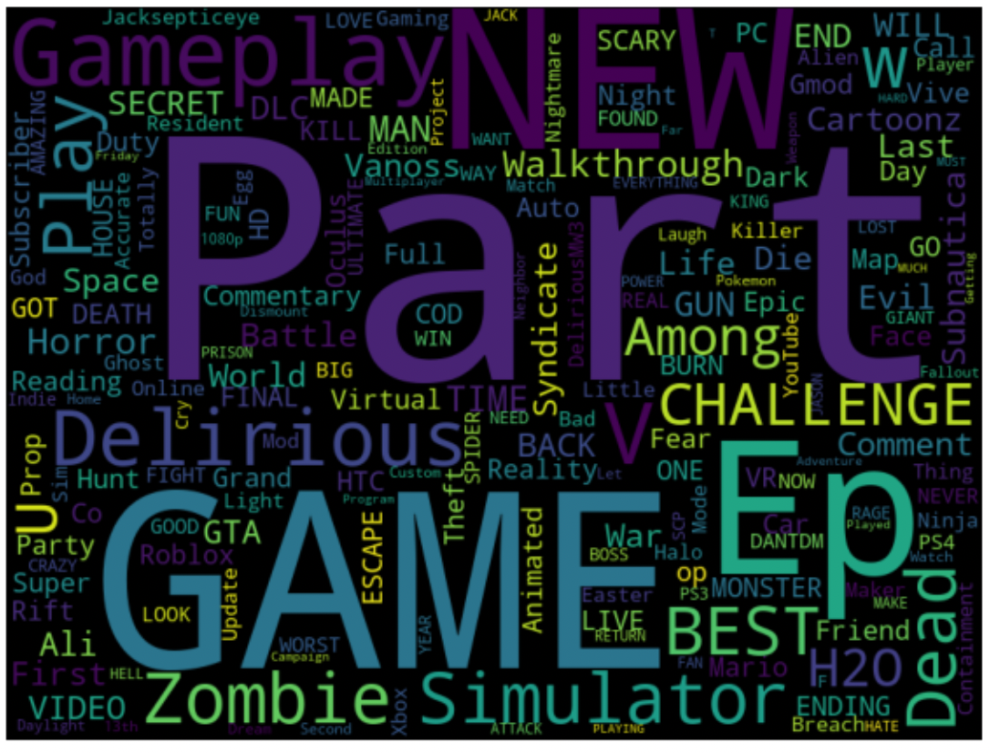
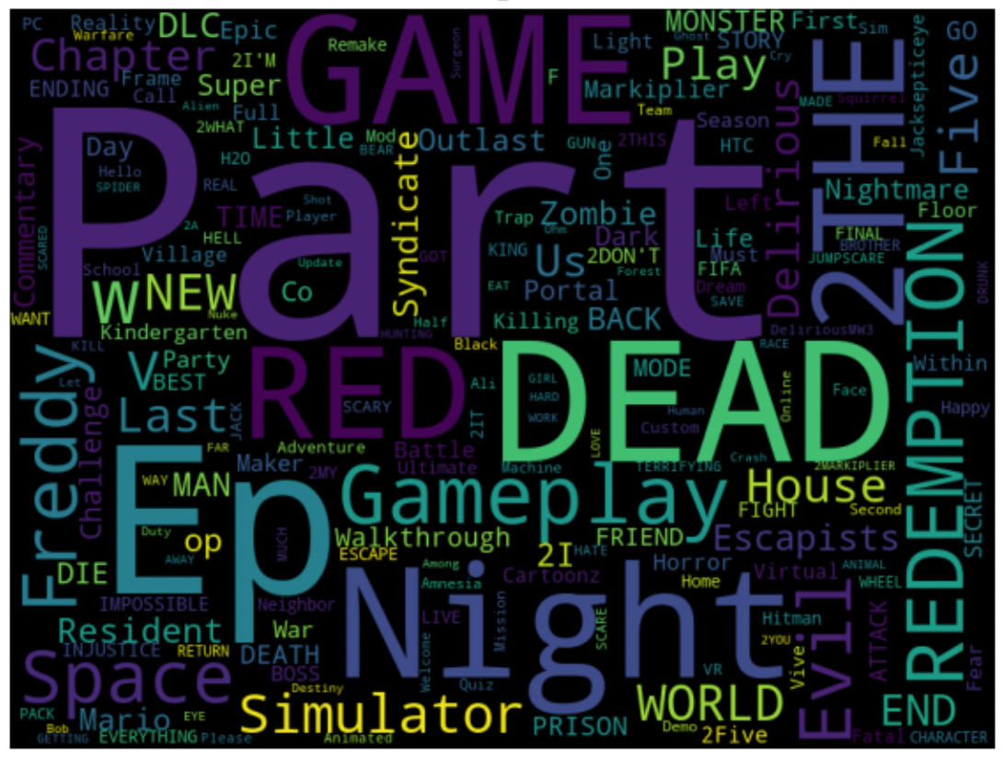
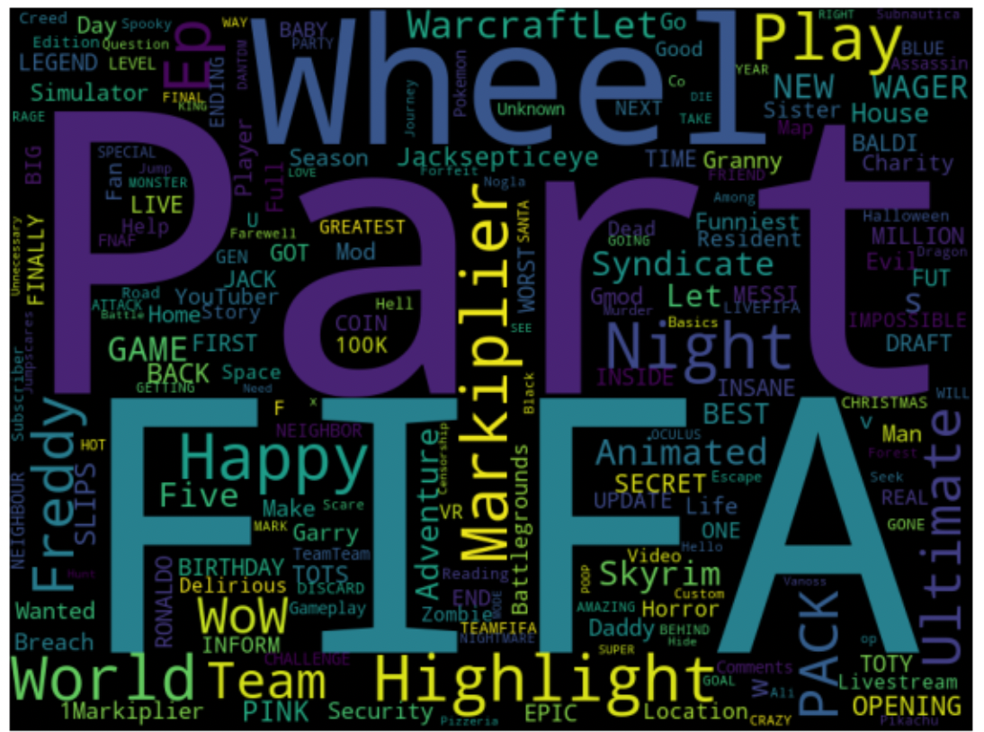
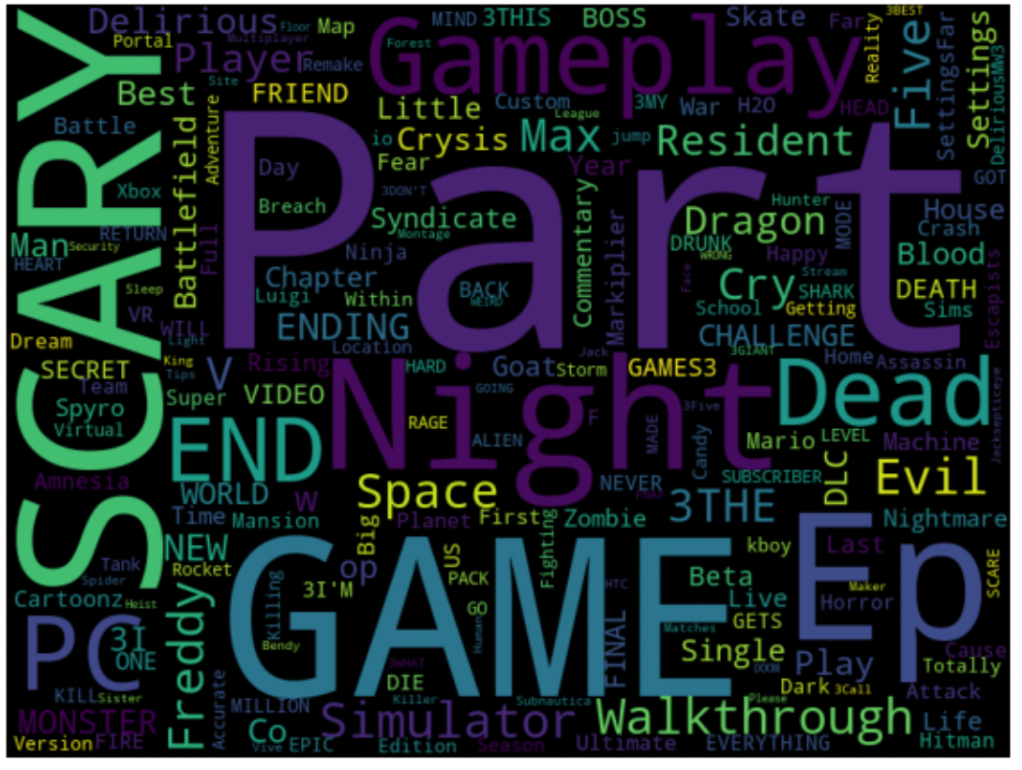
4
Modeling

